Slide 1
R Programming project
Chess data Analysis
- Nithin S [PES2201800654]
- Pavan Sai [PES2201800484

Slide 2
General Info
This is a set of just over 20,000 games collected from a selection of users on the site Lichess.org, and how to collect more. I will also upload more games in the future as I collect them. This set contains the:
Game ID;
Rated (T/F);
Start Time;
End Time;
Number of Turns;
Game Status;
Winner;
Time Increment;
White Player ID;
White Player Rating;
Black Player ID;
Black Player Rating;
All Moves in Standard Chess Notation;
Opening Eco
Opening Name;
Opening Ply (Number of moves in the opening phase)
For each of these separate games from Lichess. I collected this data using the Lichess API, which enables collection of any given users game history. The difficult part was collecting usernames to use, however the API also enables dumping of all users in a Lichess team. There are several teams on Lichess with over 1,500 players, so this proved an effective way to get users to collect games from.
About the Dataset

Slide 3
Lots of information is contained within a single chess game, let alone a full dataset of multiple games.
It is primarily a game of patterns, and data science is all about detecting patterns in data, which is why chess has been one of the most invested in areas of AI in the past.
This dataset collects all of the information available from 20,000 games and presents it in a format that is easy to process for analysis of, for example, what allows a player to win as black or white, how much meta (out-of-game) factors affect a game, the relationship between openings and victory for black and white and more.
Complete in-depth analysis of 20000 chess games played worldwide.
Analysing which opening move could lead you to a high win probability will surely help chess players all around the world.
Calculating how time increments of a chess game can change the result of the game.
Applying these pre-known tactics can help chess players choose their move.
Analysing this processed data will give a clear view of the result of the game soon after the first move.
Objectives

Slide 4
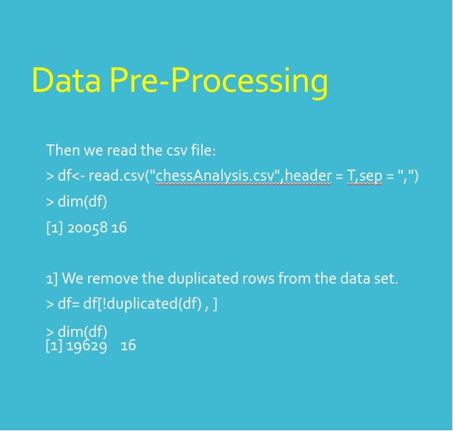
Libraries used
library(ggplot2) // Used to plot different graphs.
library(dplyr) //Used for data manipulation.
library(statsr) //Used for sampling distributions , hypothesis testing etc.,
library(gridExtra) //Merge two graphs
library(corrplot) //Used to plot the graph for correlation matrix.

Slide 5
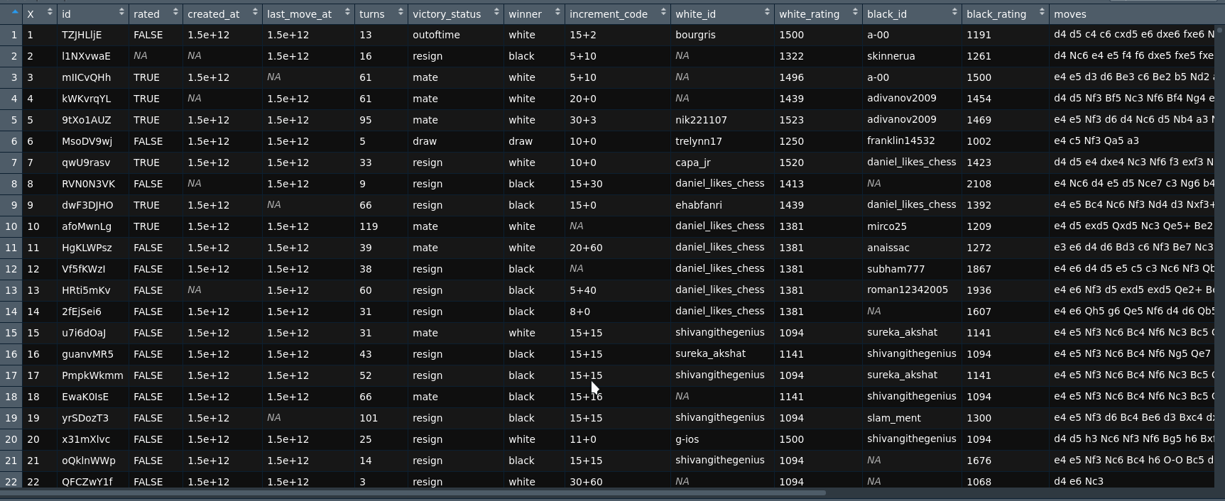
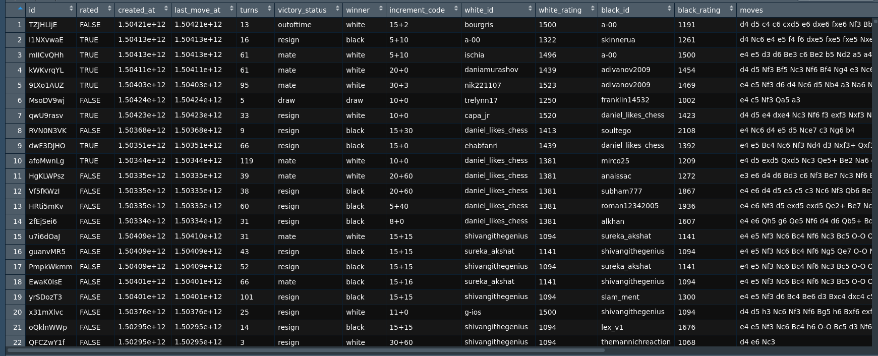
Removing NA values
> sum(is.na(df[]))
[1] 16732
> for(i in length(df[])){if(is.na(df[][i])) df[][i]=df[][i-1]}
> sum(is.na(df[])) [1] 0

Slide 6
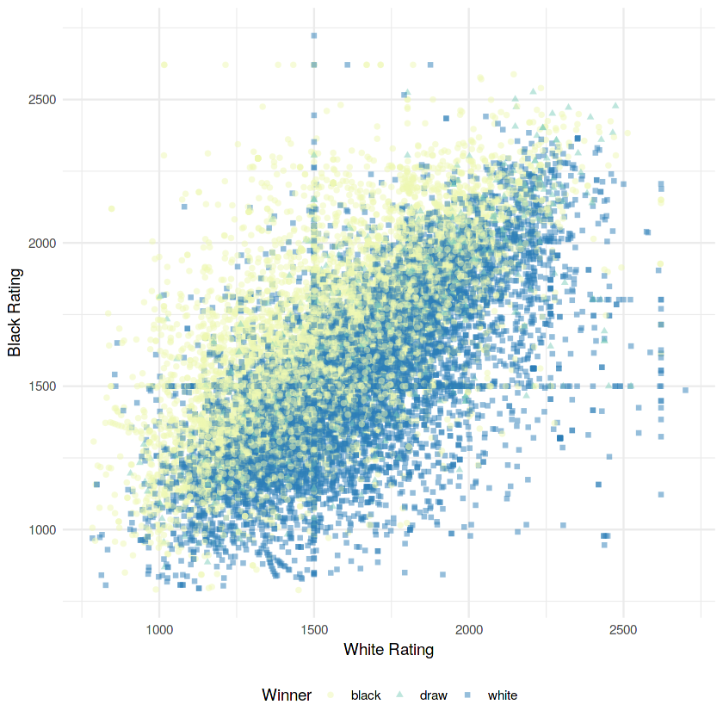
Player Ratings
ggplot(chess, aes(x = white_rating, y = black_rating, color = winner, shape = winner))+ geom_point(alpha = 0.5)+ theme_minimal()+ theme(legend.position = "bottom")+ scale_color_brewer(palette = 16)+ labs(y = "Black Rating", x = "White Rating", color = "Winner", shape = "Winner")

Slide 7
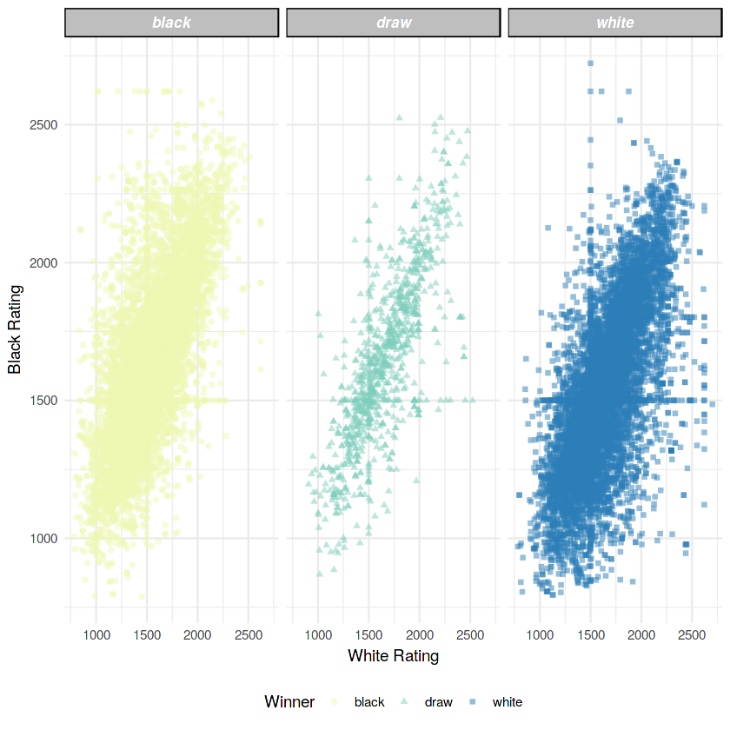
Player Ratings v/s Game Result
ggplot(chess, aes(x = white_rating, y = black_rating, color = winner, shape = winner))+ geom_point(alpha = 0.5)+ theme_minimal()+ theme(strip.background =element_rect(fill="gray"), strip.text.x = element_text(size = 10, colour = "white",face = "bold.italic"), legend.position = "bottom")+ scale_color_brewer(palette = 16)+ facet_wrap(winner~.)+ labs(y = "Black Rating", x = "White Rating", color = "Winner", shape = "Winner")

Slide 8
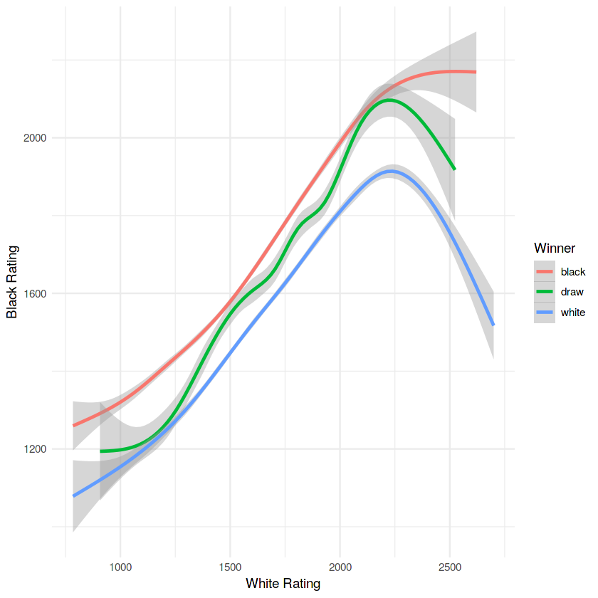
Player Ratings v/s Game Result
ggplot(chess, aes(x = white_rating, y = black_rating, color = winner, shape = winner))+ geom_smooth()+ theme_minimal()+ labs(y = "Black Rating", x = "White Rating", color = "Winner")

Slide 9
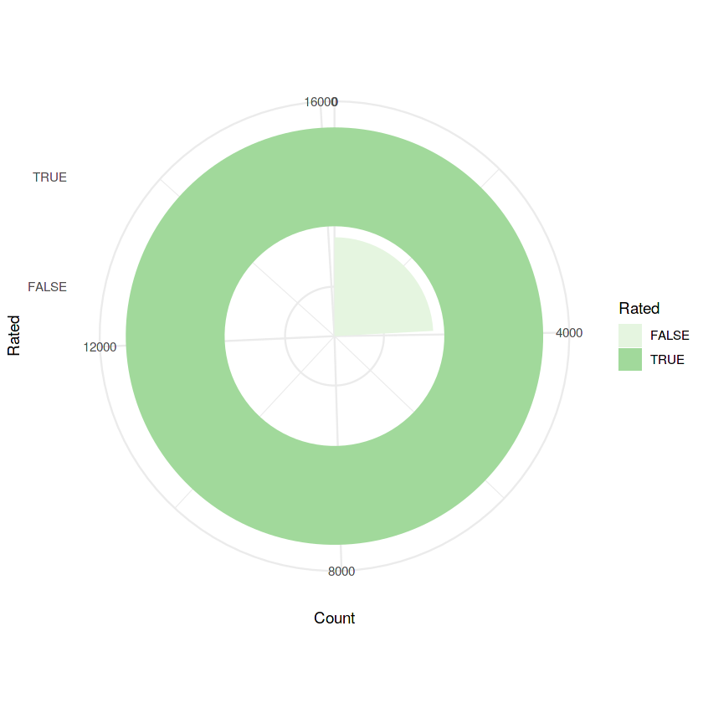
Game Ratings
ggplot(chess, aes(toupper(rated), fill = toupper(rated)))+ geom_bar()+ scale_fill_brewer(palette = 5)+ theme_minimal()+ coord_polar(theta = "y")+ labs(x = "Rated", fill = "Rated", y = "Count")

Slide 10
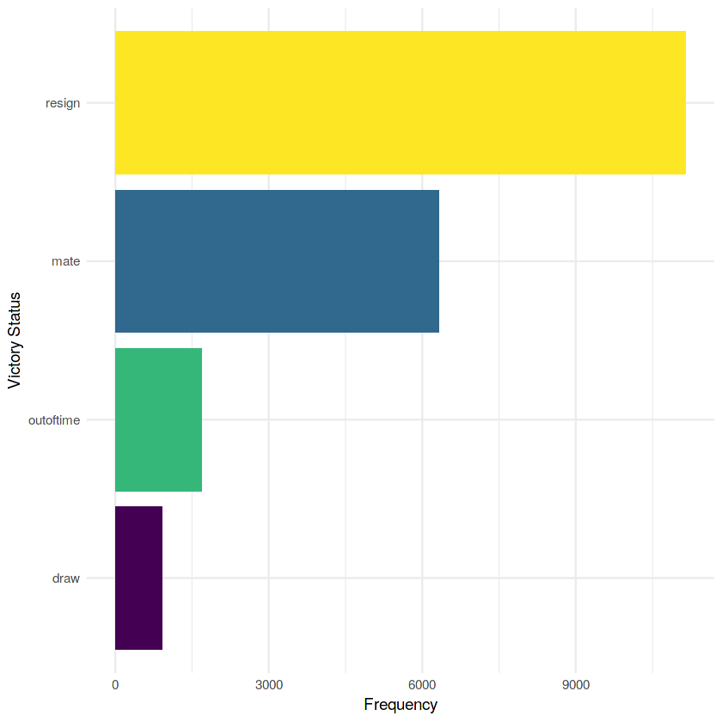
Frequency of game endings
chess %>% count(victory_status) %>% ggplot(aes(reorder(victory_status,n),n, fill = victory_status))+ geom_col(show.legend = FALSE)+ scale_fill_viridis_d()+ theme_minimal()+ coord_flip()+ labs(x = "Victory Status", y = "Frequency")

Slide 11
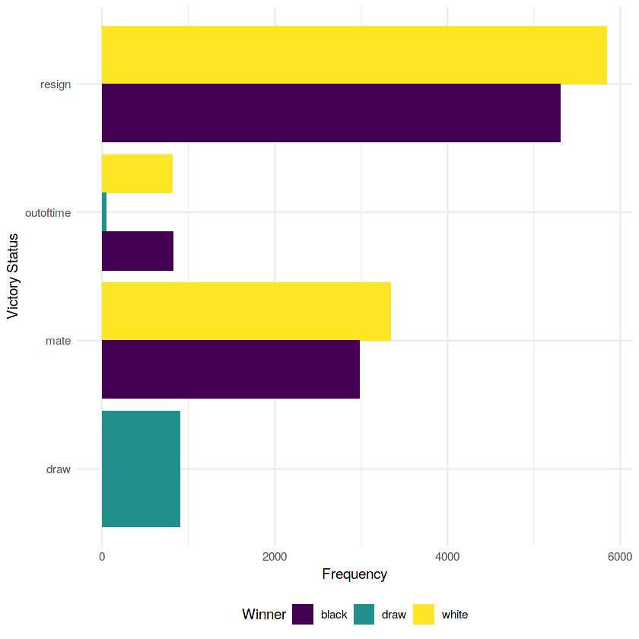
Frequency of game endings w.r.t color
ggplot(chess, aes(victory_status, fill = winner))+ geom_bar(position = "dodge")+ scale_fill_viridis_d()+ theme_minimal()+ theme(legend.position = "bottom")+ coord_flip()+ labs(x = "Victory Status", y = "Frequency", fill = "Winner")

Slide 12
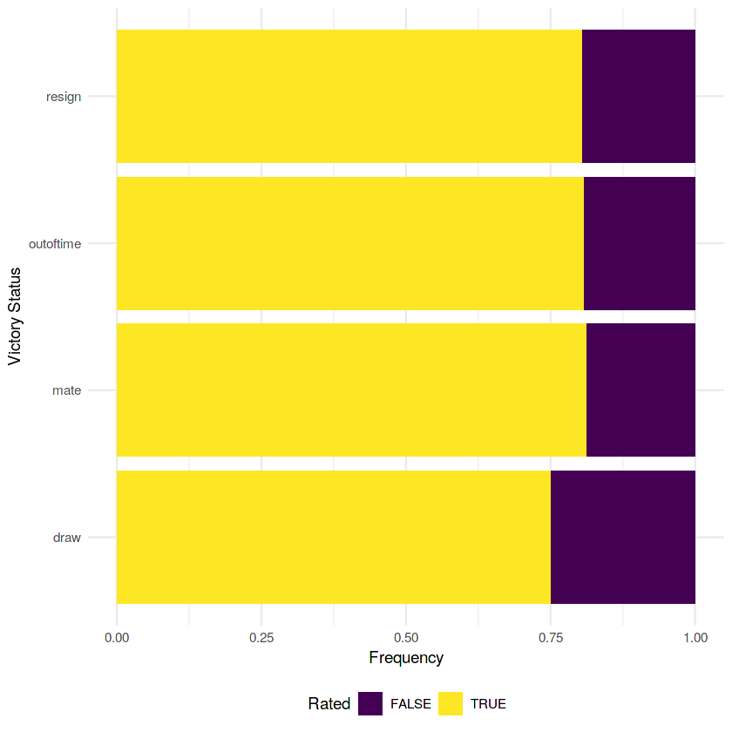
Frequency of game endings w.r.t color
ggplot(chess, aes(victory_status, fill = toupper(rated)))+ geom_bar(position = "fill")+ scale_fill_viridis_d()+ theme_minimal()+ theme(legend.position = "bottom")+ coord_flip()+ labs(x = "Victory Status", y = "Frequency", fill = "Rated")

Slide 13
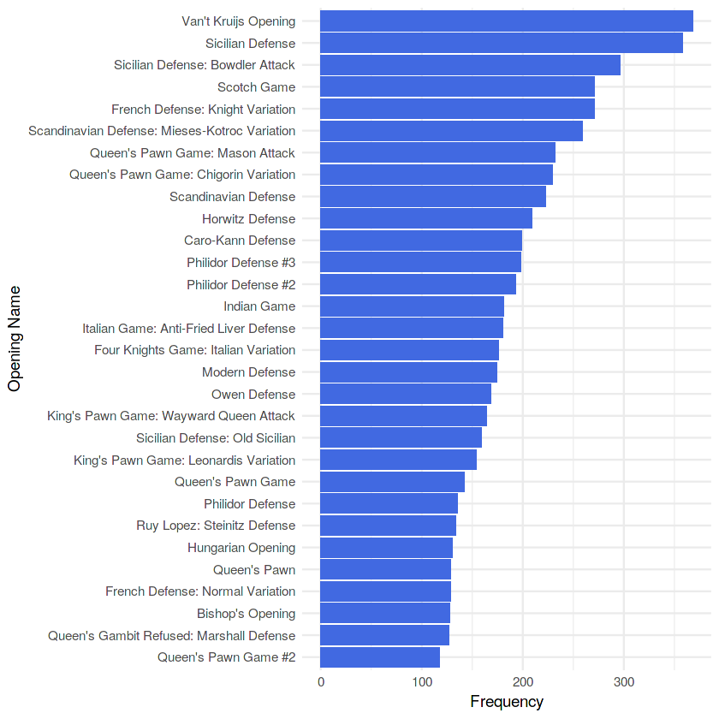
Game opening moves
chess %>% count(opening_name, sort = TRUE) %>% head(30) %>% ggplot(aes(reorder(opening_name,n), n))+ geom_col(fill = "royalblue")+ coord_flip()+ theme_minimal()+ labs(y = "Frequency", x = "Opening Name")

Slide 14
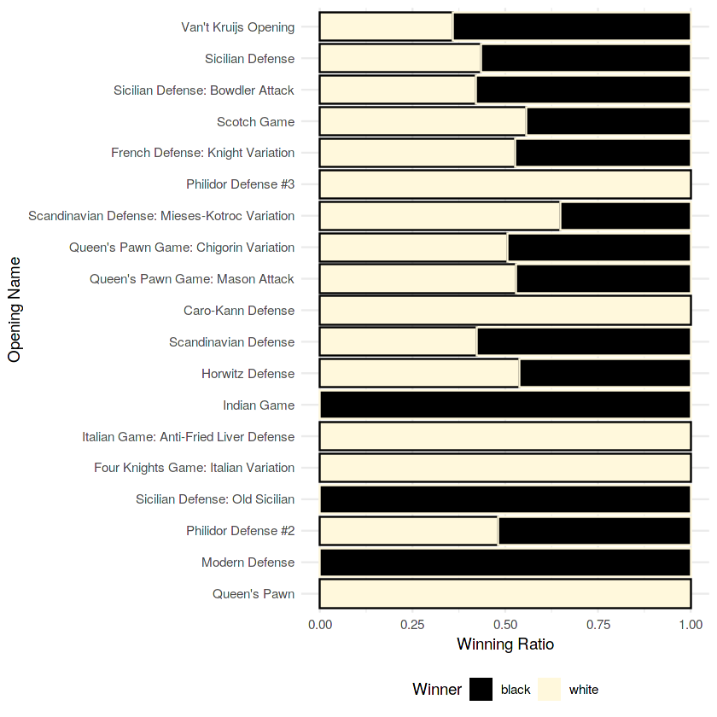
Opening moves winning probability w.r.t colour
chess %>% group_by(winner) %>% count(opening_name, sort = TRUE) %>% head(30) %>% ggplot(aes(reorder(opening_name,n), n, fill = winner, color = winner))+ geom_col(position = "fill")+ coord_flip()+ theme_minimal()+ scale_fill_manual(values = c("black", "cornsilk"))+ scale_color_manual(values = c("cornsilk", "black"))+ labs(y = "Winning Ratio", x = "Opening Name", fill = "Winner")+ guides(color = FALSE)+ theme(legend.position = "bottom")

Slide 15
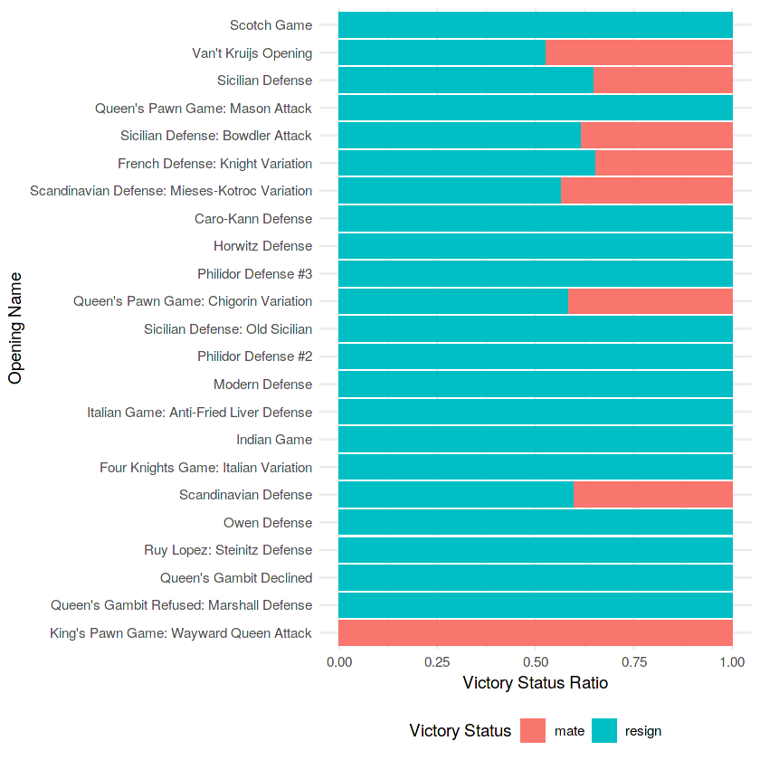
Opening moves w.r.t victory status
chess %>% group_by(victory_status ) %>% count(opening_name, sort = TRUE) %>% head(30) %>% ggplot(aes(reorder(opening_name,n), n, fill = victory_status ))+ geom_col(position = "fill")+ coord_flip()+ theme_minimal()+ labs(y = "Victory Status Ratio", x = "Opening Name", fill = "Victory Status")+ theme(legend.position = "bottom")

Slide 16
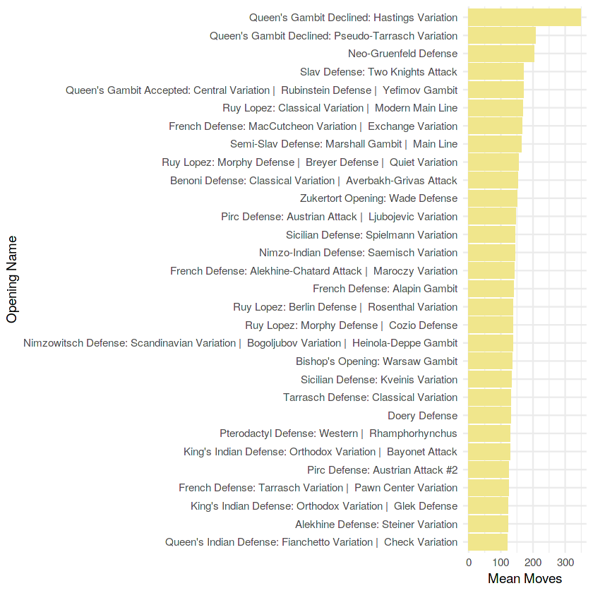
Mean of opening moves
chess %>% group_by(opening_name) %>% summarise(mean_moves = mean(moves_length)) %>% arrange(-mean_moves) %>% head(30) %>% ggplot(aes(reorder(opening_name,mean_moves), mean_moves))+ geom_col(fill = "khaki")+ theme_minimal()+ coord_flip()+ labs(x = "Opening Name", y = "Mean Moves")

Slide 17
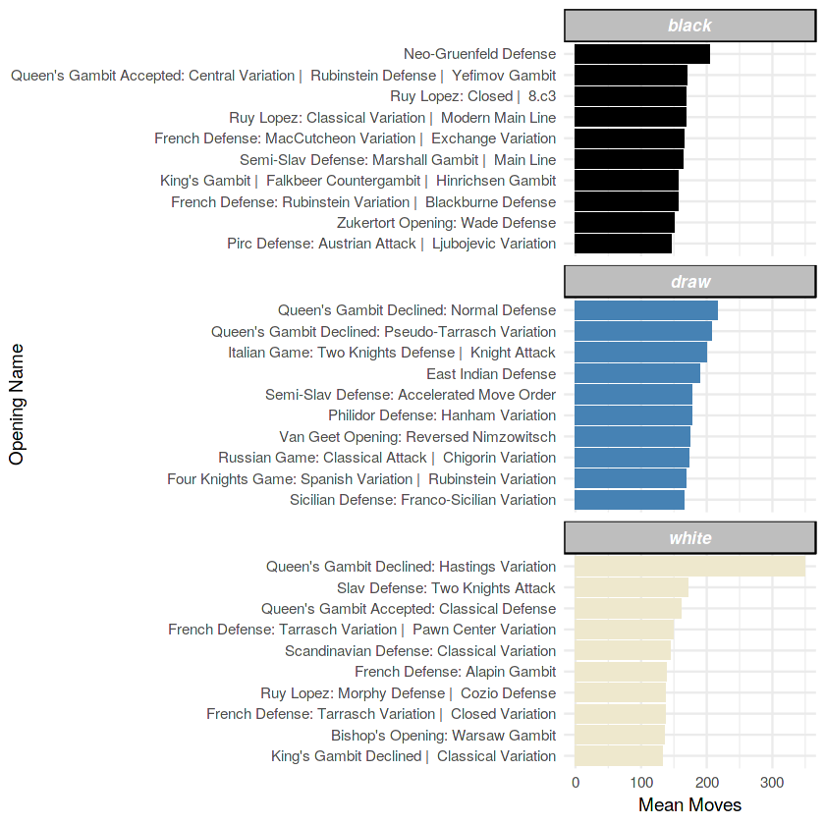
Opening moves winning probability w.r.t colour
chess %>% group_by(opening_name, winner) %>% summarise(mean_moves = mean(moves_length)) %>% arrange(-mean_moves) %>% ungroup() %>% group_by(winner) %>% top_n(10) %>% ggplot(aes(reorder(opening_name, mean_moves), mean_moves, fill = winner)) + geom_col(show.legend = FALSE)+ coord_flip()+ facet_wrap(~winner, scales = "free_y", ncol = 1) + theme_minimal()+ theme(strip.background =element_rect(fill="gray"), strip.text.x = element_text(size = 10, colour = "white",face = "bold.italic"))+ labs(x = "Opening Name", y = "Mean Moves")+ scale_fill_manual(values = c("black", "steelblue", "cornsilk2"))

Slide 18
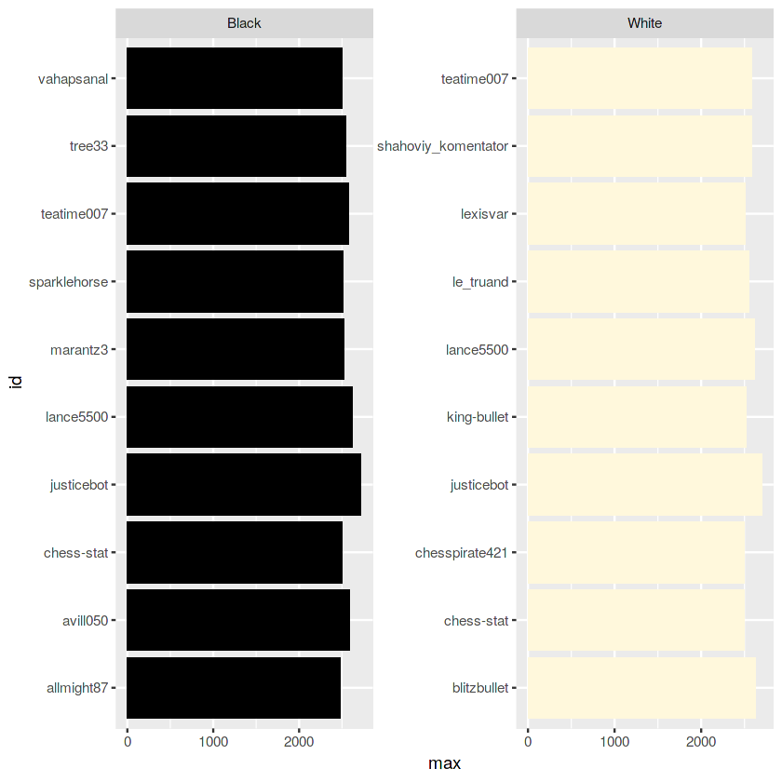
Top 10 players in each category w.r.t colour
bind_rows( chess %>% group_by(white_id) %>% summarise(max = max(white_rating)) %>% top_n(10) %>% ungroup() %>% mutate(color = "White") %>% rename(id = white_id), chess %>% group_by(black_id) %>% summarise(max = max(black_rating)) %>% top_n(10) %>% ungroup() %>% mutate(color = "Black") %>% rename(id = black_id) ) %>% ggplot(aes(id, max, fill = color))+ geom_col(show.legend = FALSE)+ coord_flip()+ facet_wrap(color~., scales = "free")+ scale_fill_manual(values = c("black", "cornsilk"))

Slide 19
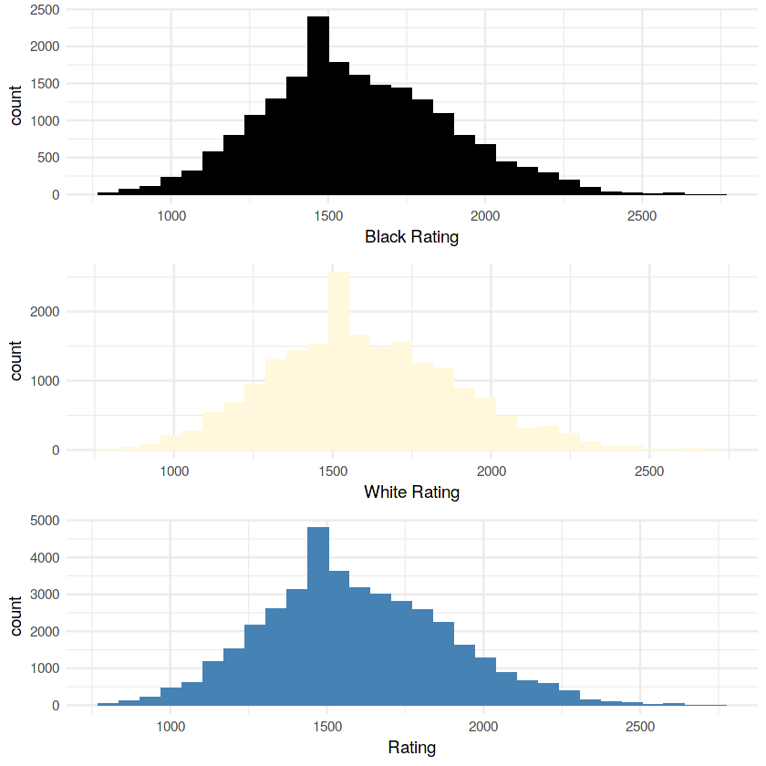
Histogram to analyse distribution of player ratings
grid.arrange( ggplot(chess,aes(black_rating))+ geom_histogram(fill = "black")+ theme_minimal()+ labs(x= "Black Rating"), ggplot(chess,aes(white_rating))+ geom_histogram(fill = "cornsilk")+ theme_minimal()+ labs(x= "White Rating"), ggplot(data.frame(rating = c(chess$white_rating, chess$black_rating)),aes(rating))+ geom_histogram(fill = "steelblue")+ theme_minimal()+ labs(x= "Rating"))

Slide 20
Hypothesis testing is a statistical procedure that uses sample data to determine, whether a statement about the value of a population parameter should or should not be rejected.
Here we do hypothesis testing for the column turns.
Our population mean was 60.466 so we assume that the sample mean is same as population mean.
Thus our Null Hypothesis will be that
H0 : µ = 60.466
H1 : µ!= 60.466
5. Hypothesis testing

Slide 21
>xbar=mean(df$turns)
>sigm=sd(df$turns)
> sigm
[1] 33.57058
> n=600
> mu=mean(df$turns[1:600])
>z = (xbar - mu)/(sigm/sqrt(n))
> z
[1] 1.068455
The test statistic 1.068455 lies between the critical values -1.9600 and 1.9600. Hence, at .05 significance level, we do not reject the null hypothesis that the sample mean is almost same as population mean
5. Hypothesis testing

Slide 22
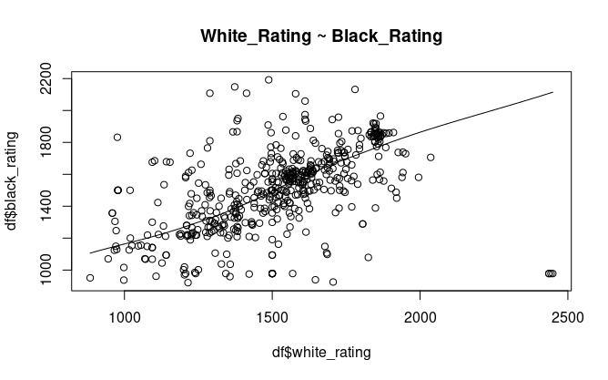
> df=df[1:500,]
> scatter.smooth(x=df$white_rating, y=df$black_rating, main="White_Rating ~ Black_Rating")
Scatter plot

Slide 23
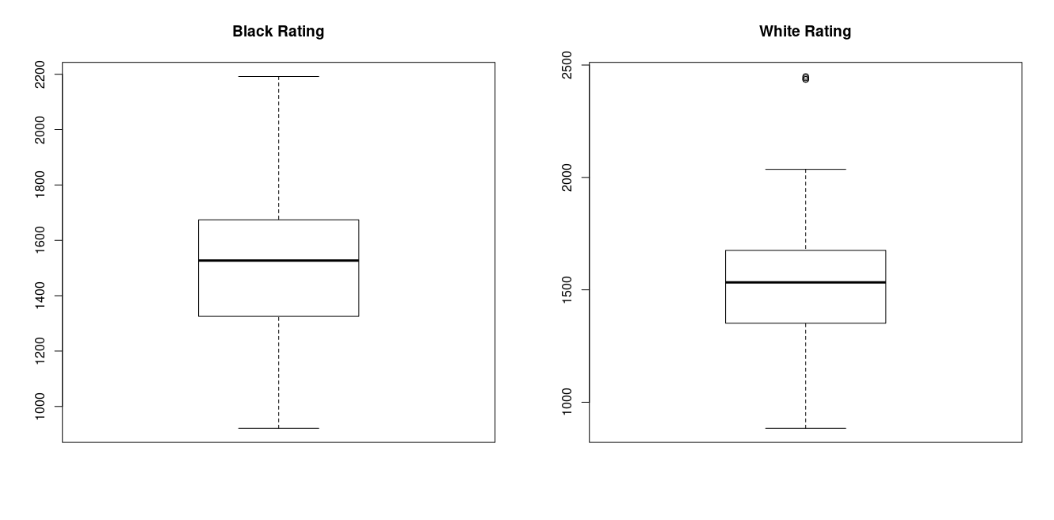
Boxplot
> boxplot(df$black_rating, main="Black Rating")
> boxplot(df$white_rating, main="White Rating")

Slide 24
Correlation
> cor(df$white_rating,df$black_rating)
[1] 0.4773239
//Before removing outliers
> black_outliers=boxplot(df$black_rating, main="Black Rating")$out
> black_outliers
numeric(0)
> white_outliers=boxplot(df$white_rating, main="White Rating")$out
> white_outliers
[1] 2449 2443 2436 2436
> df <- df[-which(df$white_rating %in% white_outliers),]
> boxplot(df$white_rating, main="White Rating")
> cor(df$white_rating,df$black_rating)
[1] 0.5822306
//After removing outliers

Slide 25
> linearmod = lm(white_rating ~ black_rating,data=df)
> linearmod
Call:
lm(formula = white_rating ~ black_rating, data = df)
Coefficients:
(Intercept) black_rating
689.5165 0.5419
> summary(linearmod)
Call:
lm(formula = white_rating ~ black_rating, data = df)
Residuals:
Min 1Q Median 3Q Max
-706.24 -106.58 17.84 120.87 550.79
Coefficients:
Estimate Std. Error t value Pr(>|t|)
(Intercept) 689.51646 51.95645 13.27 <2e-16 ***
black_rating 0.54188 0.03404 15.92 <2e-16 ***
---
Signif. codes: 0 ‘***’ 0.001 ‘**’ 0.01 ‘*’ 0.05 ‘.’ 0.1 ‘ ’ 1
Residual standard error: 191.2 on 494 degrees of freedom
Multiple R-squared: 0.339, Adjusted R-squared: 0.3377
F-statistic: 253.3 on 1 and 494 DF, p-value: < 2.2e-16
Correlation

Slide 26
> trainingRowIndex = sample(1:nrow(df),0.8*nrow(df))
> trainingData = df[trainingRowIndex, ]
> testData = df[-trainingRowIndex, ]
> lmMod = lm(white_rating ~ black_rating,data=trainingData)
> ratingPred = predict(lmMod,testData)
> actualPreds = data.frame(cbind(actuals=testData$black_rating,predicteds=ratingPred))
> correlation_accuracy <- cor(actualPreds)
Linear Regression Model

Slide 27
Linear Regression Model
> head(actualPreds)
actuals predicteds
6 1002 1228.613
12 1867 1772.890
21 1676 1652.709
39 978 1213.511
40 978 1213.511
45 978 1213.511
> min_max_accuracy <- mean(apply(actualPreds, 1, min) / apply(actualPreds, 1, max))
> min_max_accuracy
[1] 0.9455716
> cvResults <- suppressWarnings(CVlm(data=df,form.lm=black_rating ~ white_rating, m=5, dots=FALSE, seed=29, legend.pos="topleft"));

Slide 28
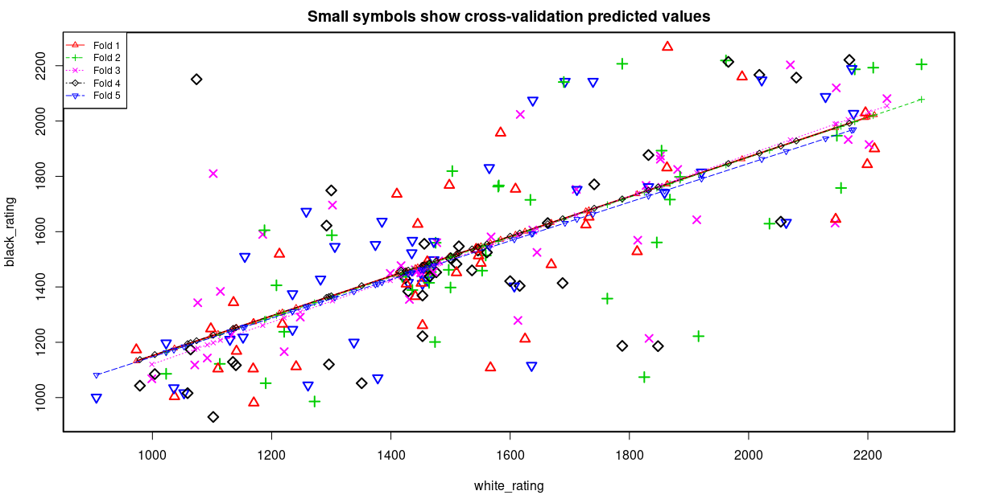
Linear Regression Model

Slide 29
Final Prediction equation
Black_rating = 689.5165 + 0.5419(White_rating)

Slide 30
Thank You

